Slide 1
Kaya Vaastu
Human beings have four protective external layers- skin, clothes, house and atmosphere. If any of these layers gets affected then a person is not able to lead a healthy life. Kaaya Vaastu is related with the human body and the rules to be conformed for its physical and mental development and progress. According to Yoga Guru Maharshi Patanjali, a person should strike a balance with his natural environment to attain health and mental peace. For this, he had devised a method named ‘asthanga yoga’ which comprises of yama, niyam, aasan, pranayam, pratyahaar, dhaarna, dhyan and Samadhi.

Slide 2
Thousands of years ago, the ancient sages had discovered that the human body has seven bodies and seven energy chakras. The seven bodies are1. Sthul sharir 2. Aakash sharir 3. Sukshma sharir 4. Manas sharir 5. Aatmik sharir 6. Vriksha sharir 7. Nirvaan sharir.
Seven chakras are 1. Muladhar chakra 2. Swadhisthan chakra 3. Manipur chakra 4. Anahat chakra 5. Vishuddha chakra 6. Aagya chakra 7. Sahasrar chakra.

Slide 3
The pictures of Hindu gods and goddesses are shown to have halo around them which is known as aura. This is the energy aspect of our physical body which works as a protective shield around our body. In the modern times, this can be seen with the help of kirlian camera and it can be measured with the help of lecher antenna and H3 Gold antenna. The five elements- earth, water, air, fire and space are said to possess different colours. Earth is green/brown, water blue, fire red and yellow, air and space sky blue. All these colours are found around us. Aura is similar to a multi-coloured mist, consisting of seven layers of energy that radiates through us and around us. In case, there is any imbalance in the colours then there are remedies too.

Slide 4
The human body is not only made up of the physical form but includes five other distinct sheaths known as ‘koshas’. Thus, each person possesses five bodies or koshas. All our ‘karmas’ (actions) and ‘sanskaras’ (experiences and memories) lie in the koshas.
The five koshas are-
Annamaya kosha (The physical sheath)
Pranamaya kosha (The energy sheath)
Manomaya kosha (The mental sheath)
Vigyanamaya kosha (The Intellectual sheath)
Anandamaya kosha (The blissful sheath)
While the first five limbs are external practices, the last three of the limbs are internal practices of Raja Yoga. The last three limbs can be practiced only when one is through with the external preliminary practices.

Slide 5
Raja yoga is one of the most systematic methods in order to achieve the highest states of meditation.
The eight limbs of Raja yoga are as follows-
Yamas (Abstinences)
Niyamas (Observances)
Asanas (Postures)
Pranayamas (control of breath)
Pratyahara (Abstraction)
Dharana (Concentration)
Dhyan (Meditation)
Samadhi (The superconscious state)
While the first five limbs are external practices, the last three of the limbs are internal practices of Raja Yoga. The last three limbs can be practiced only when one is through with the external preliminary practices.

Slide 6
Yog Tatva Mudra Vigyan or Science of Gestures
The five fingers in our hands also represent these five elements. To govern and utilize this wonderful natural mechanism, our learned sages, after a long research, had discovered Yog Tatva Mudra Vigyan or Science of Gestures. These gestures act just like a remote control to regulate the human body.
Science of mudras is an excellent resource which the body possesses. Mudras, here, mean the different kind of postures formed by joining and crossing of the fingers of either one or both hands. As per Mudra Vigyan, it is stated that there is a tremendous energy flow in the hands. Each finger symbolizes one of the five elements- agni (fire), vayu (air), akash (ether), prithvi (earth) and jal (water).

Slide 7
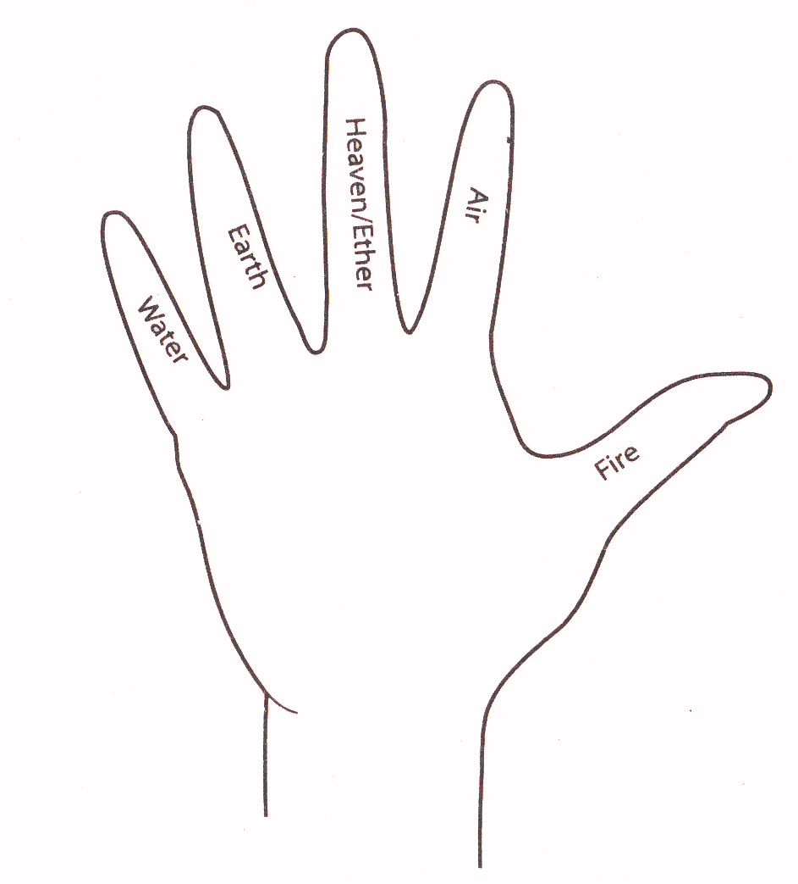
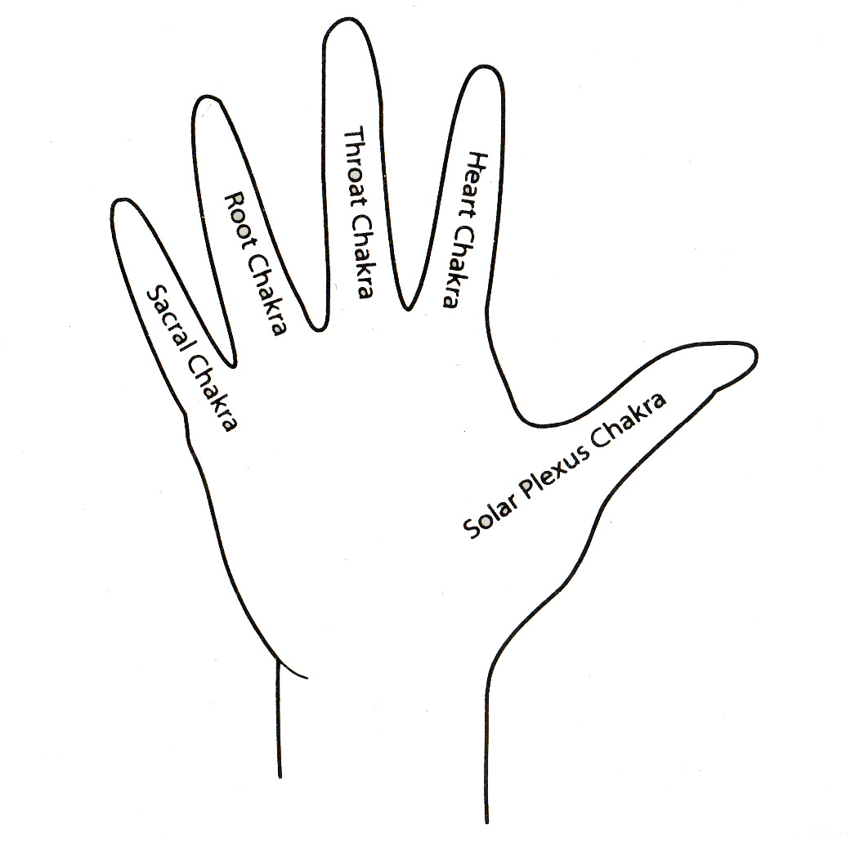
Five Elements and Fingers
Chakra and Fingers

Slide 8
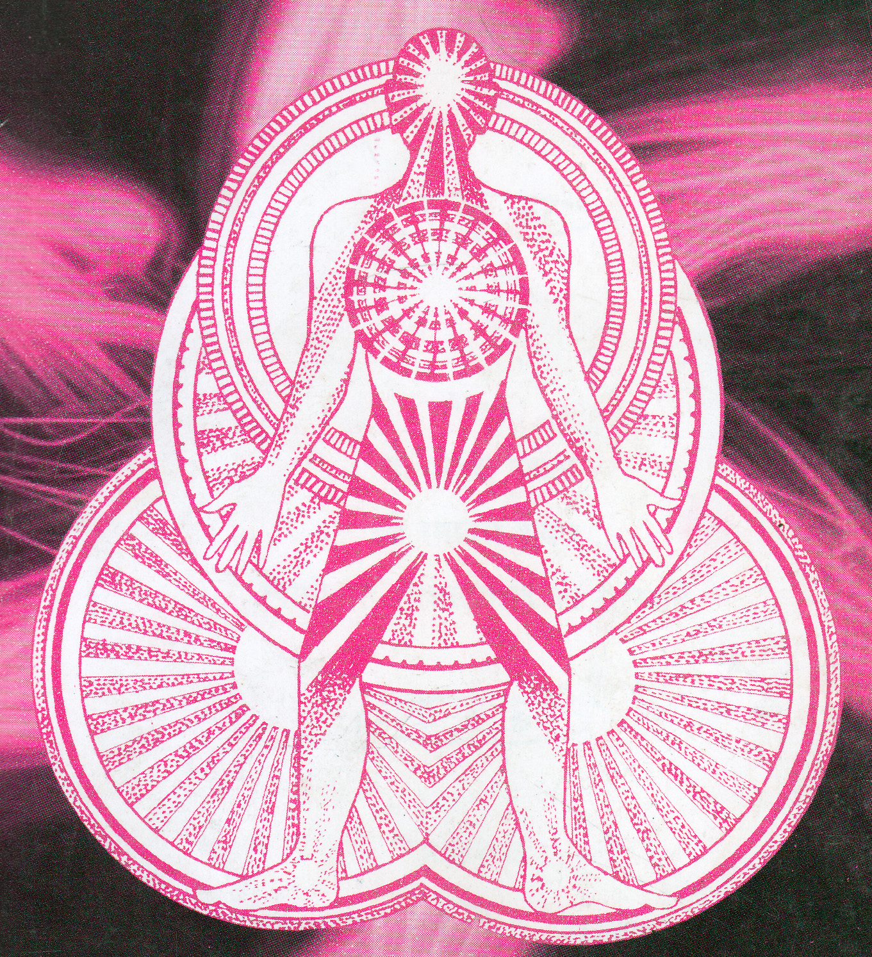

Slide 9
Crown - Sahasrara Pineal
Brow - Ajna Pituitary
Throat - Vishudhi Thyroid
Heart - Anahata Thymus
Solar - Manipura Solar Plexus
Splenic - Swadistana Adrenals
Base - Muladhara Gonads
COMBINING ESOTERIC KNOWLEDGE WITH MODERN UNDERSTANDING
CHAKRAS relate to
ENDOCRINE & GLANDULAR SYSTEMS

Slide 10
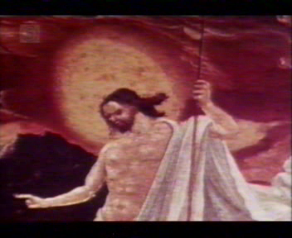
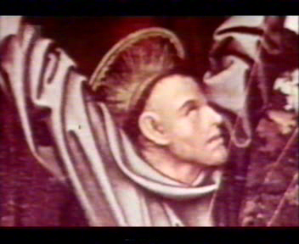
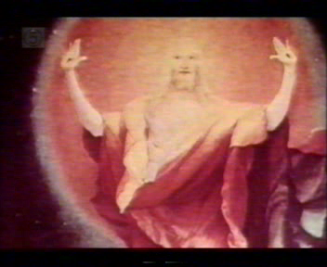
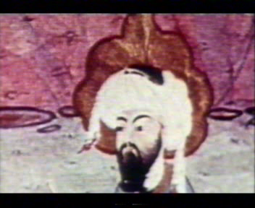
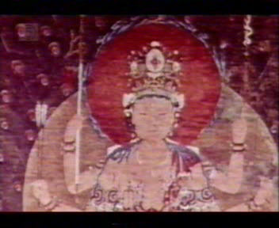
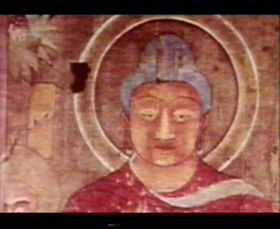
All major religions depict Energy Fields, Halos, Auras & Coronas
TRUTH is the ONLY religion & above All

Slide 11
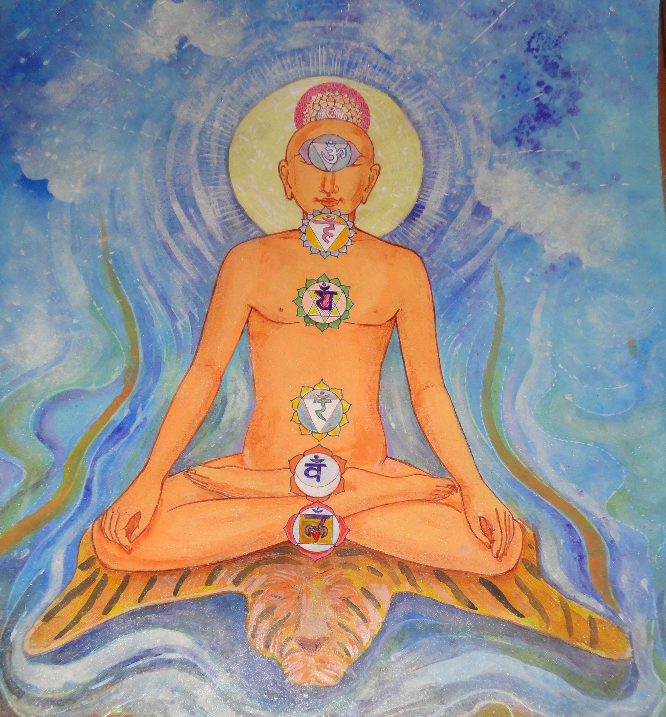

Slide 13
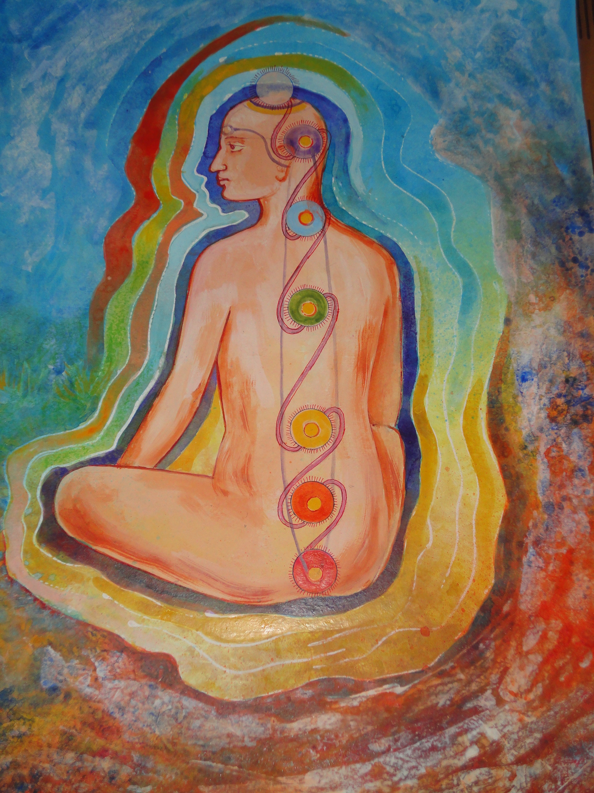

Slide 14
COLOURS AND THEIR ENERGY LEVELS
White | Violet = Highest Energy
Indigo | Blue = Good Energy
Green | Yellow = Moderate Energy
Orange | Red = Stressful Energy
Pink | Grey = Weakest Energy
Black = No Energy

Slide 15
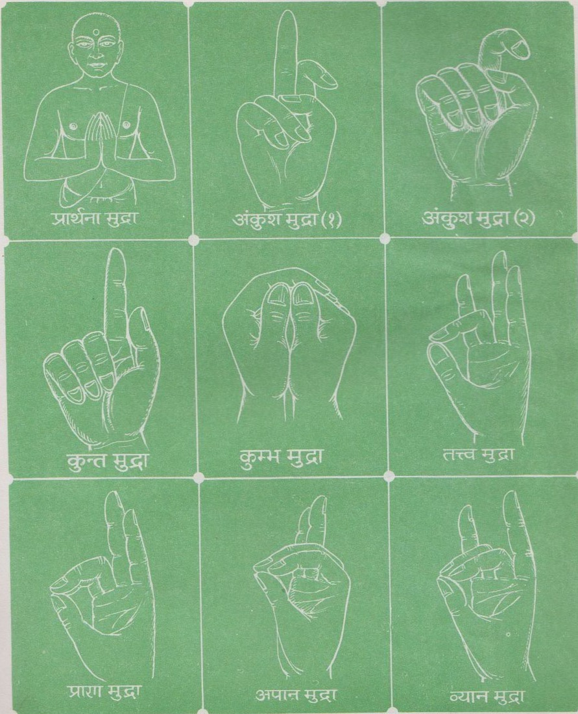
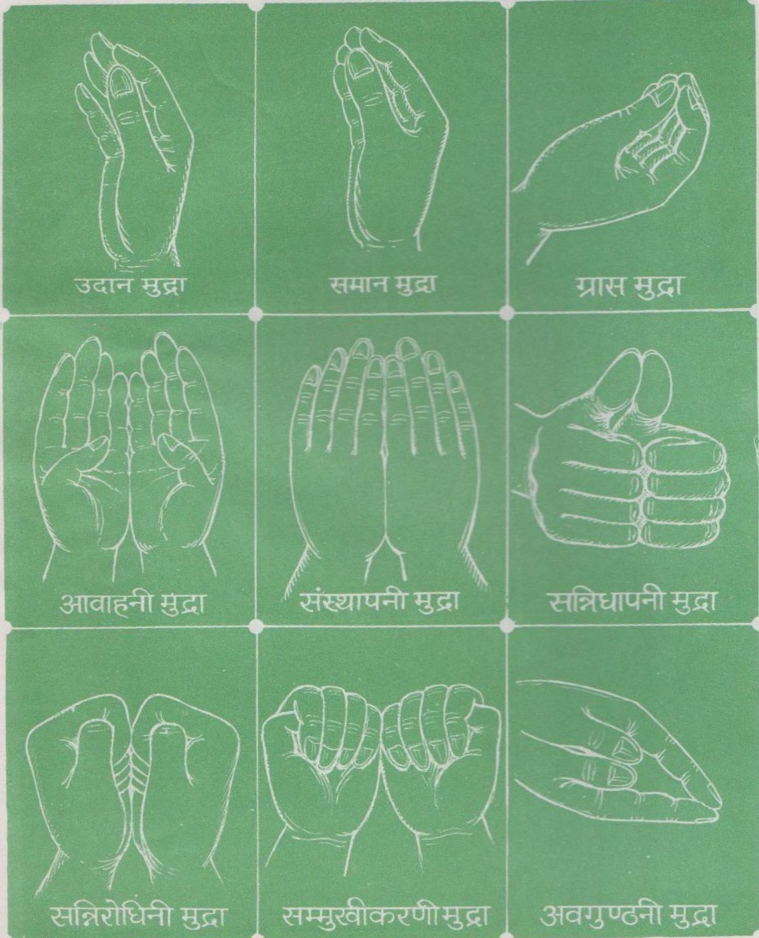

Slide 16
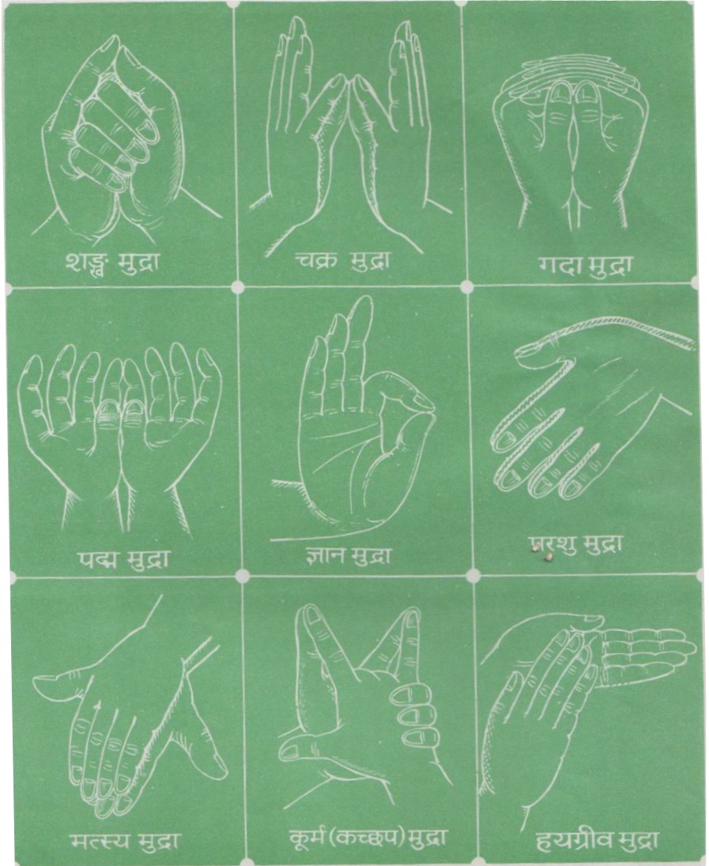
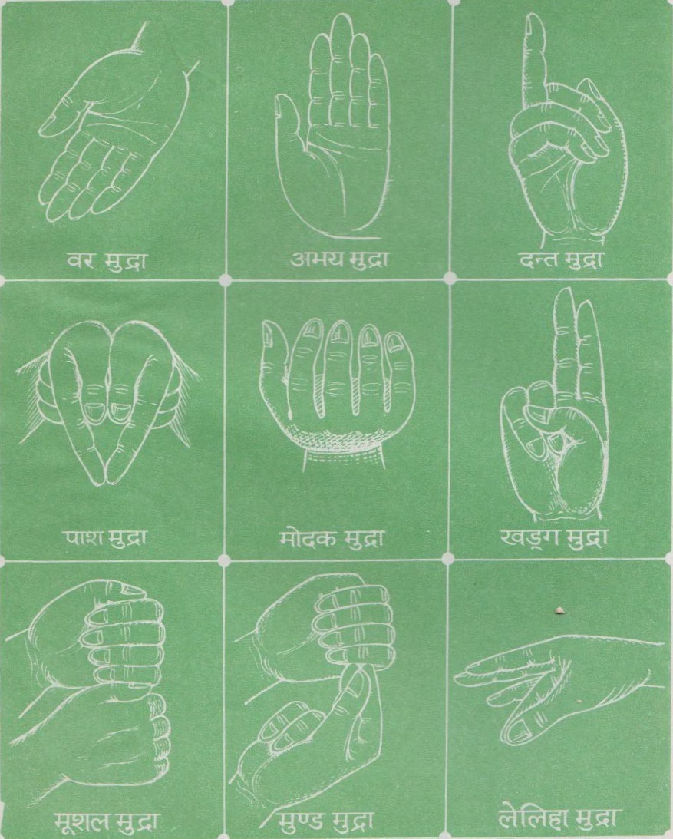

Slide 17
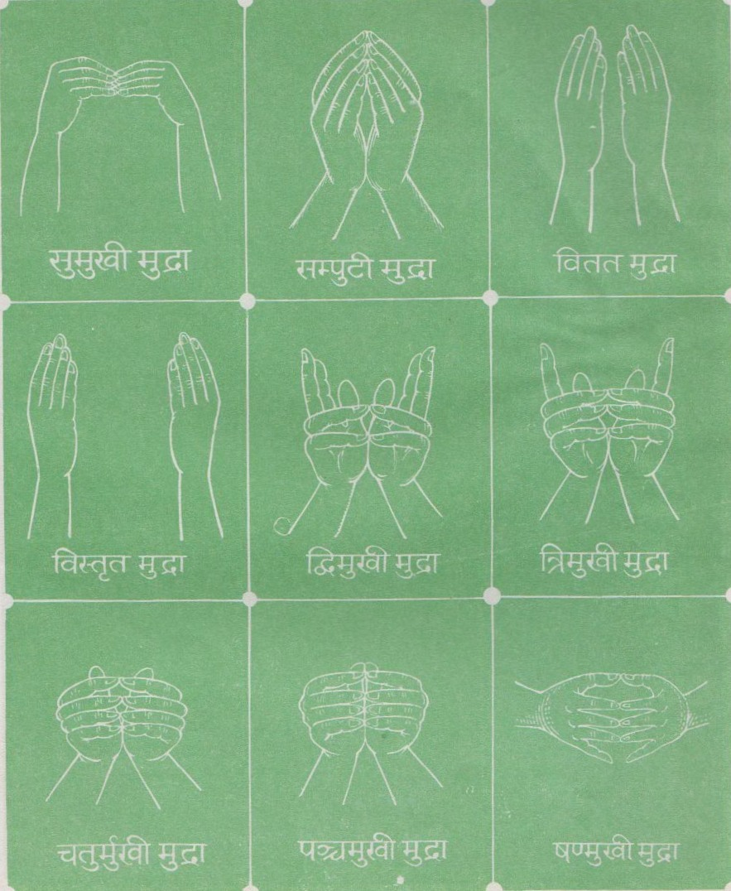
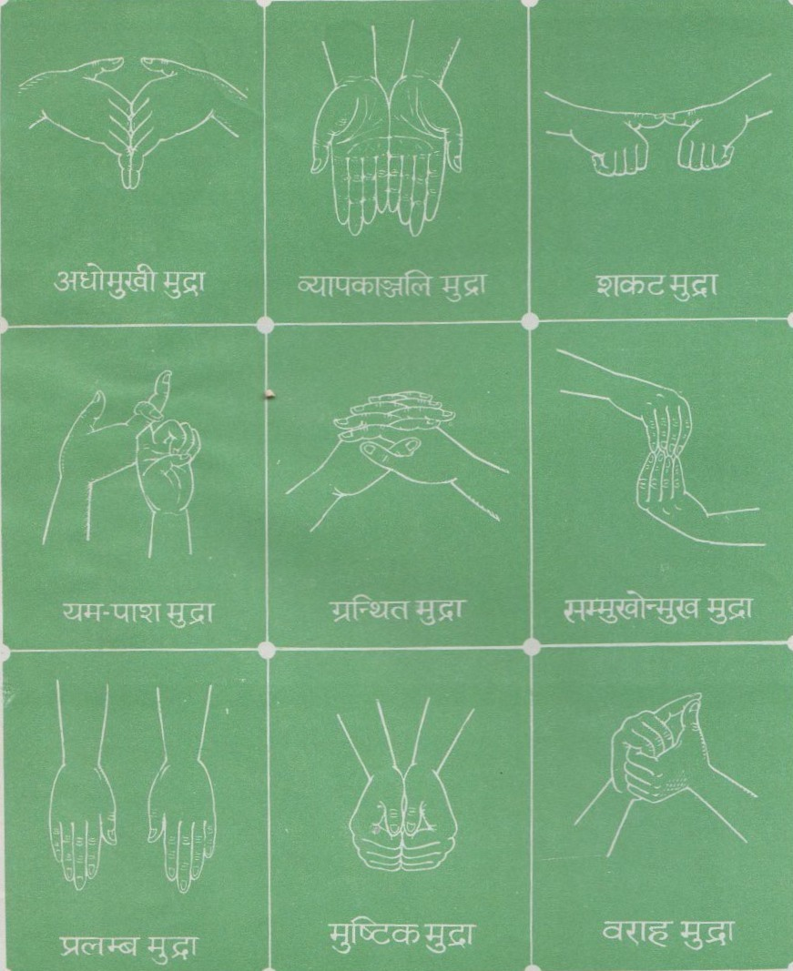

Slide 19
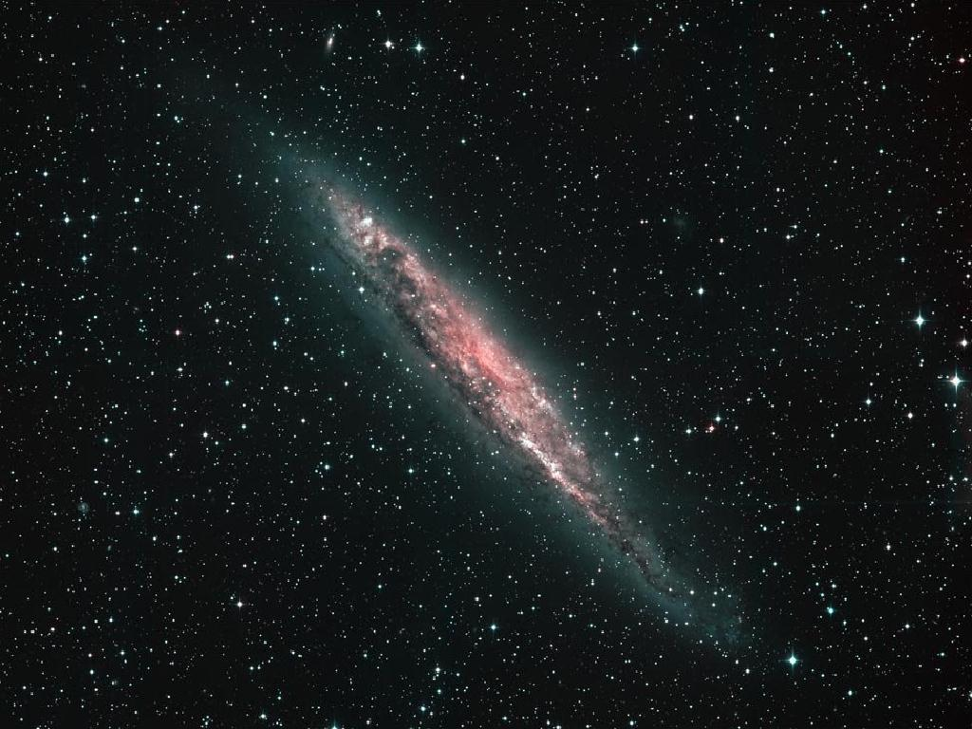
Nothing happens in Nature without an energy exchange. Communication or acquisition of knowledge of any kind occurs only with an energy transfer.
There are no exceptions. This is a rule of nature. ~Milo Wolff, Geoff Haselhurst, 2005

Slide 20
What is energy? In physics, energy is defined as the ability to do work.
Sound can do the work of vibrating the hairs in your cochlea so you can hear.

Slide 21
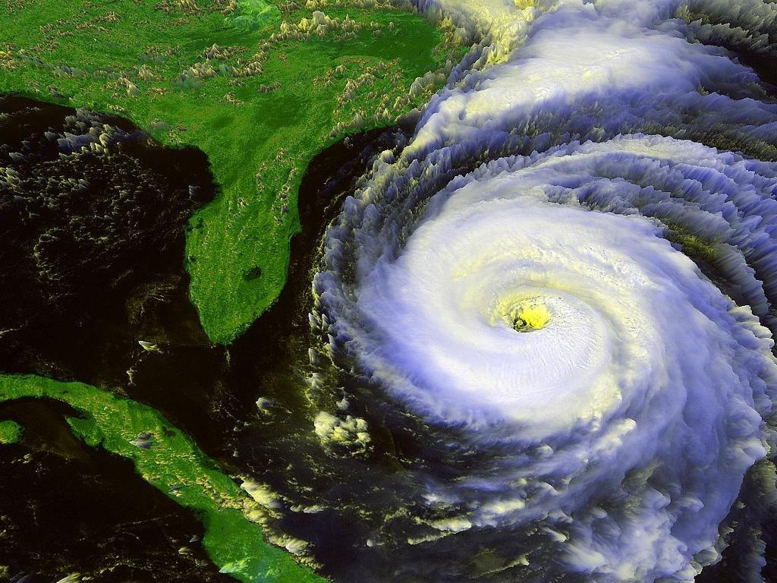
What is energy?

Slide 22
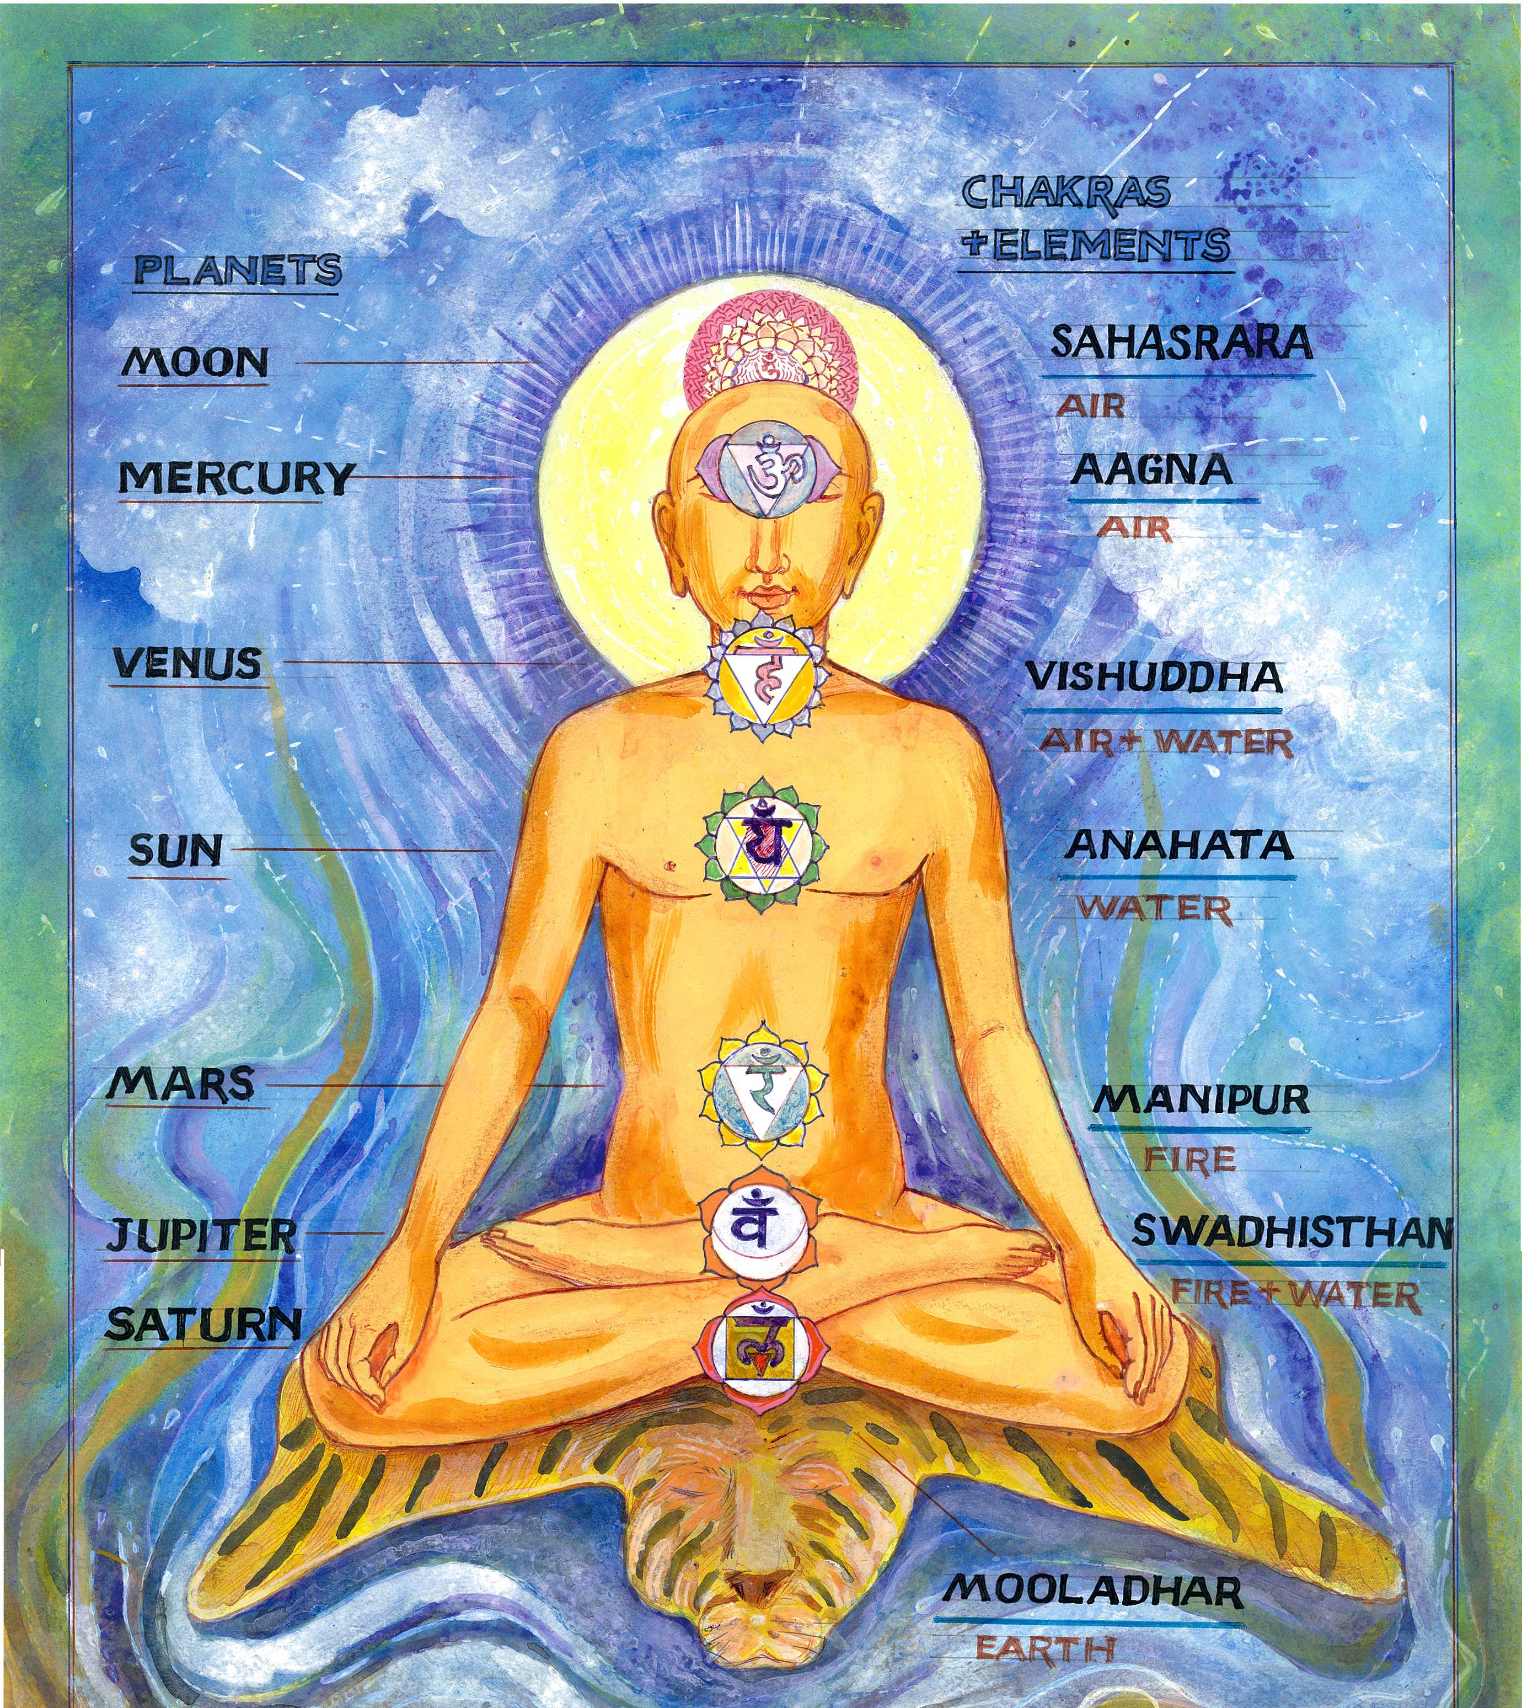
ELEMENTS, DIRECTIONS, PLANETS & CHAKRA

Slide 23
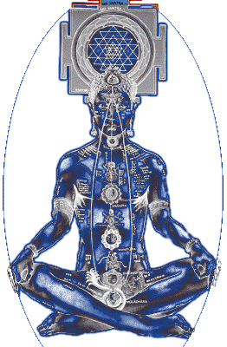
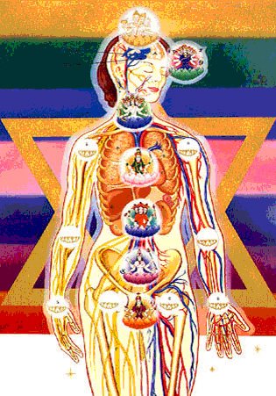
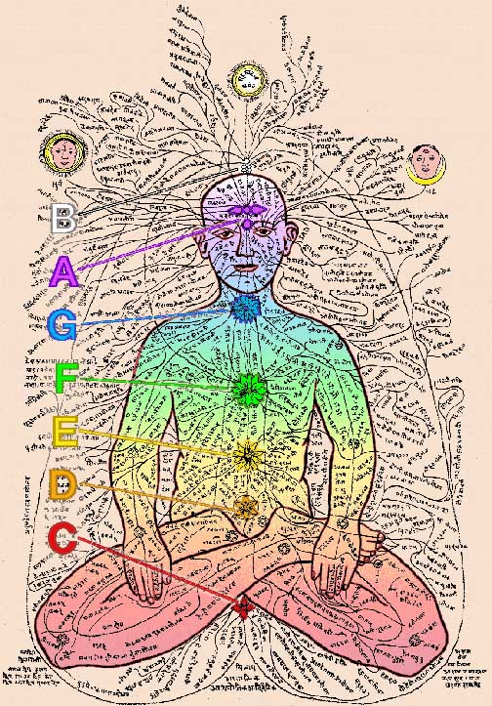
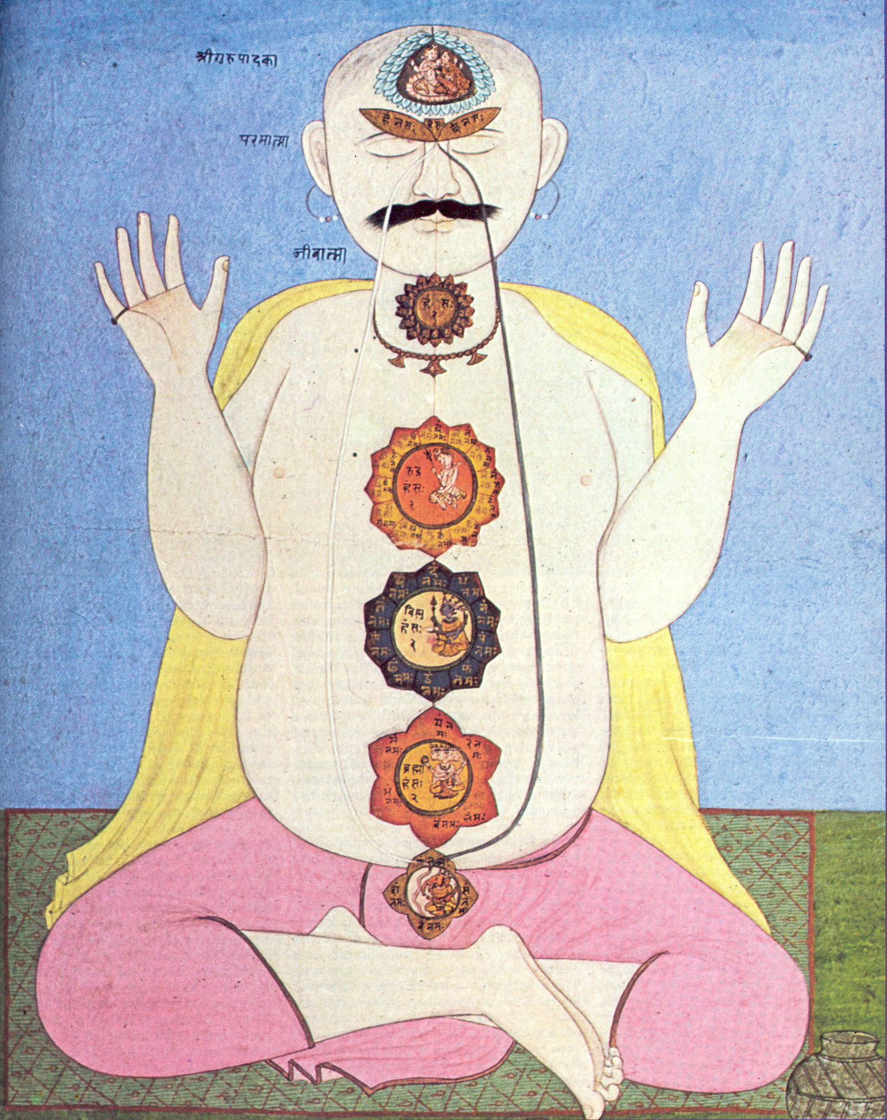
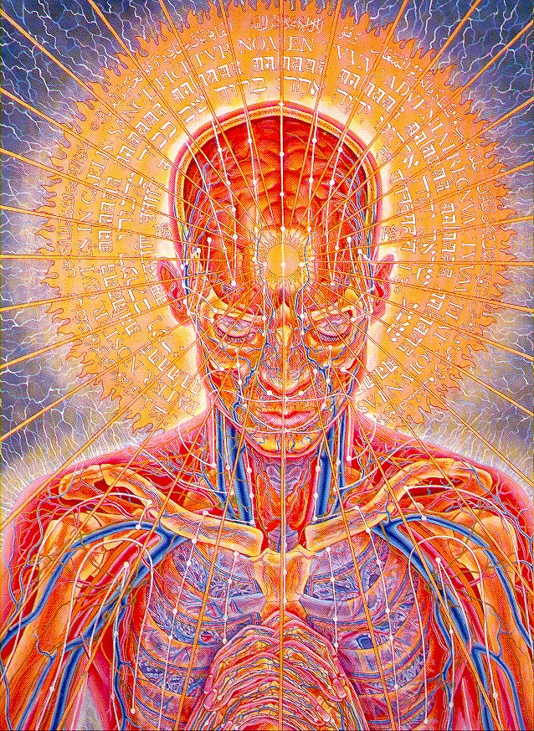
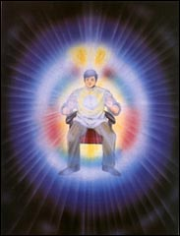
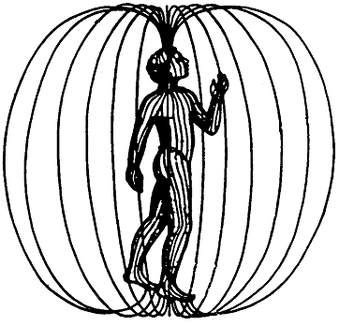
The chakras form the front line of the bodies homeostasis

Slide 24
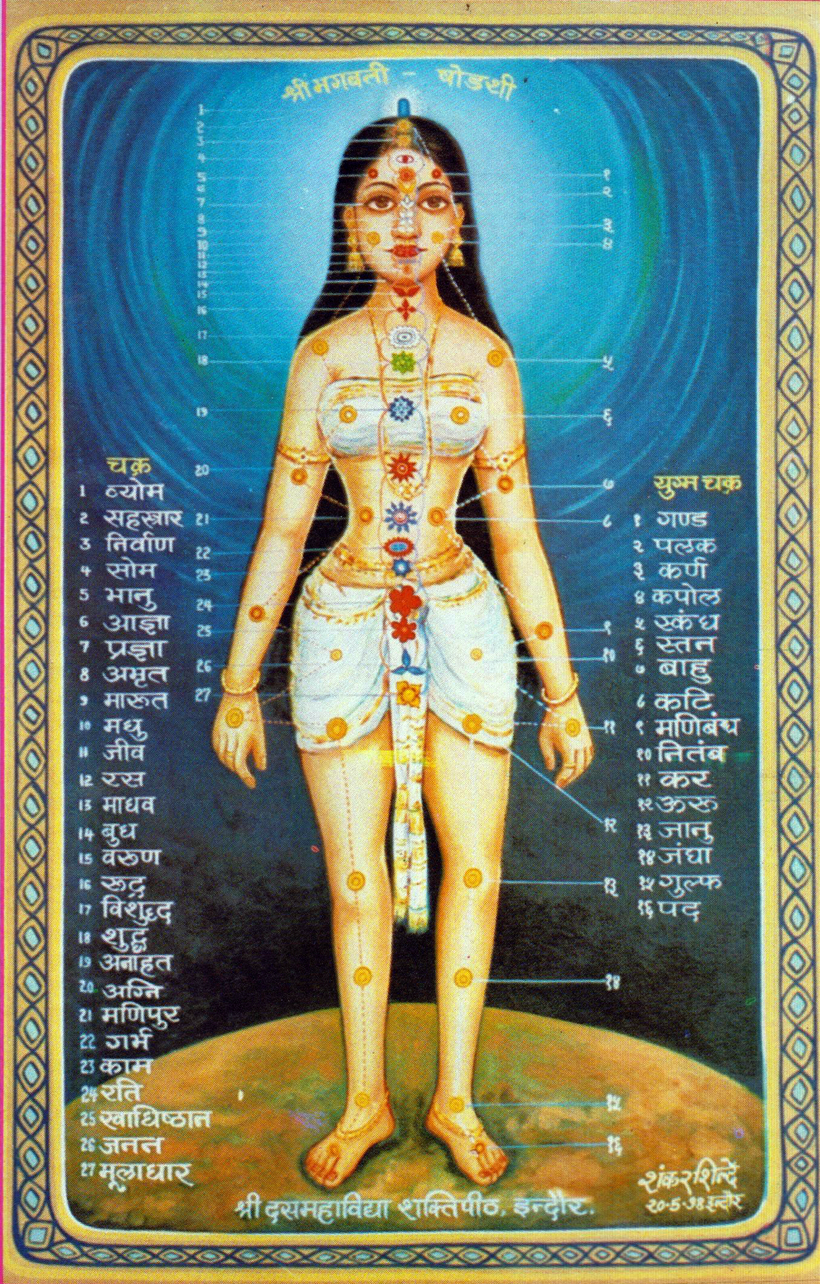

Slide 25
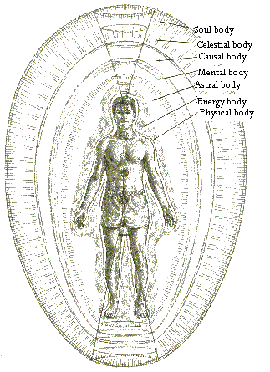
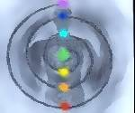
The layers of the biofield and the flow of energy

Slide 26
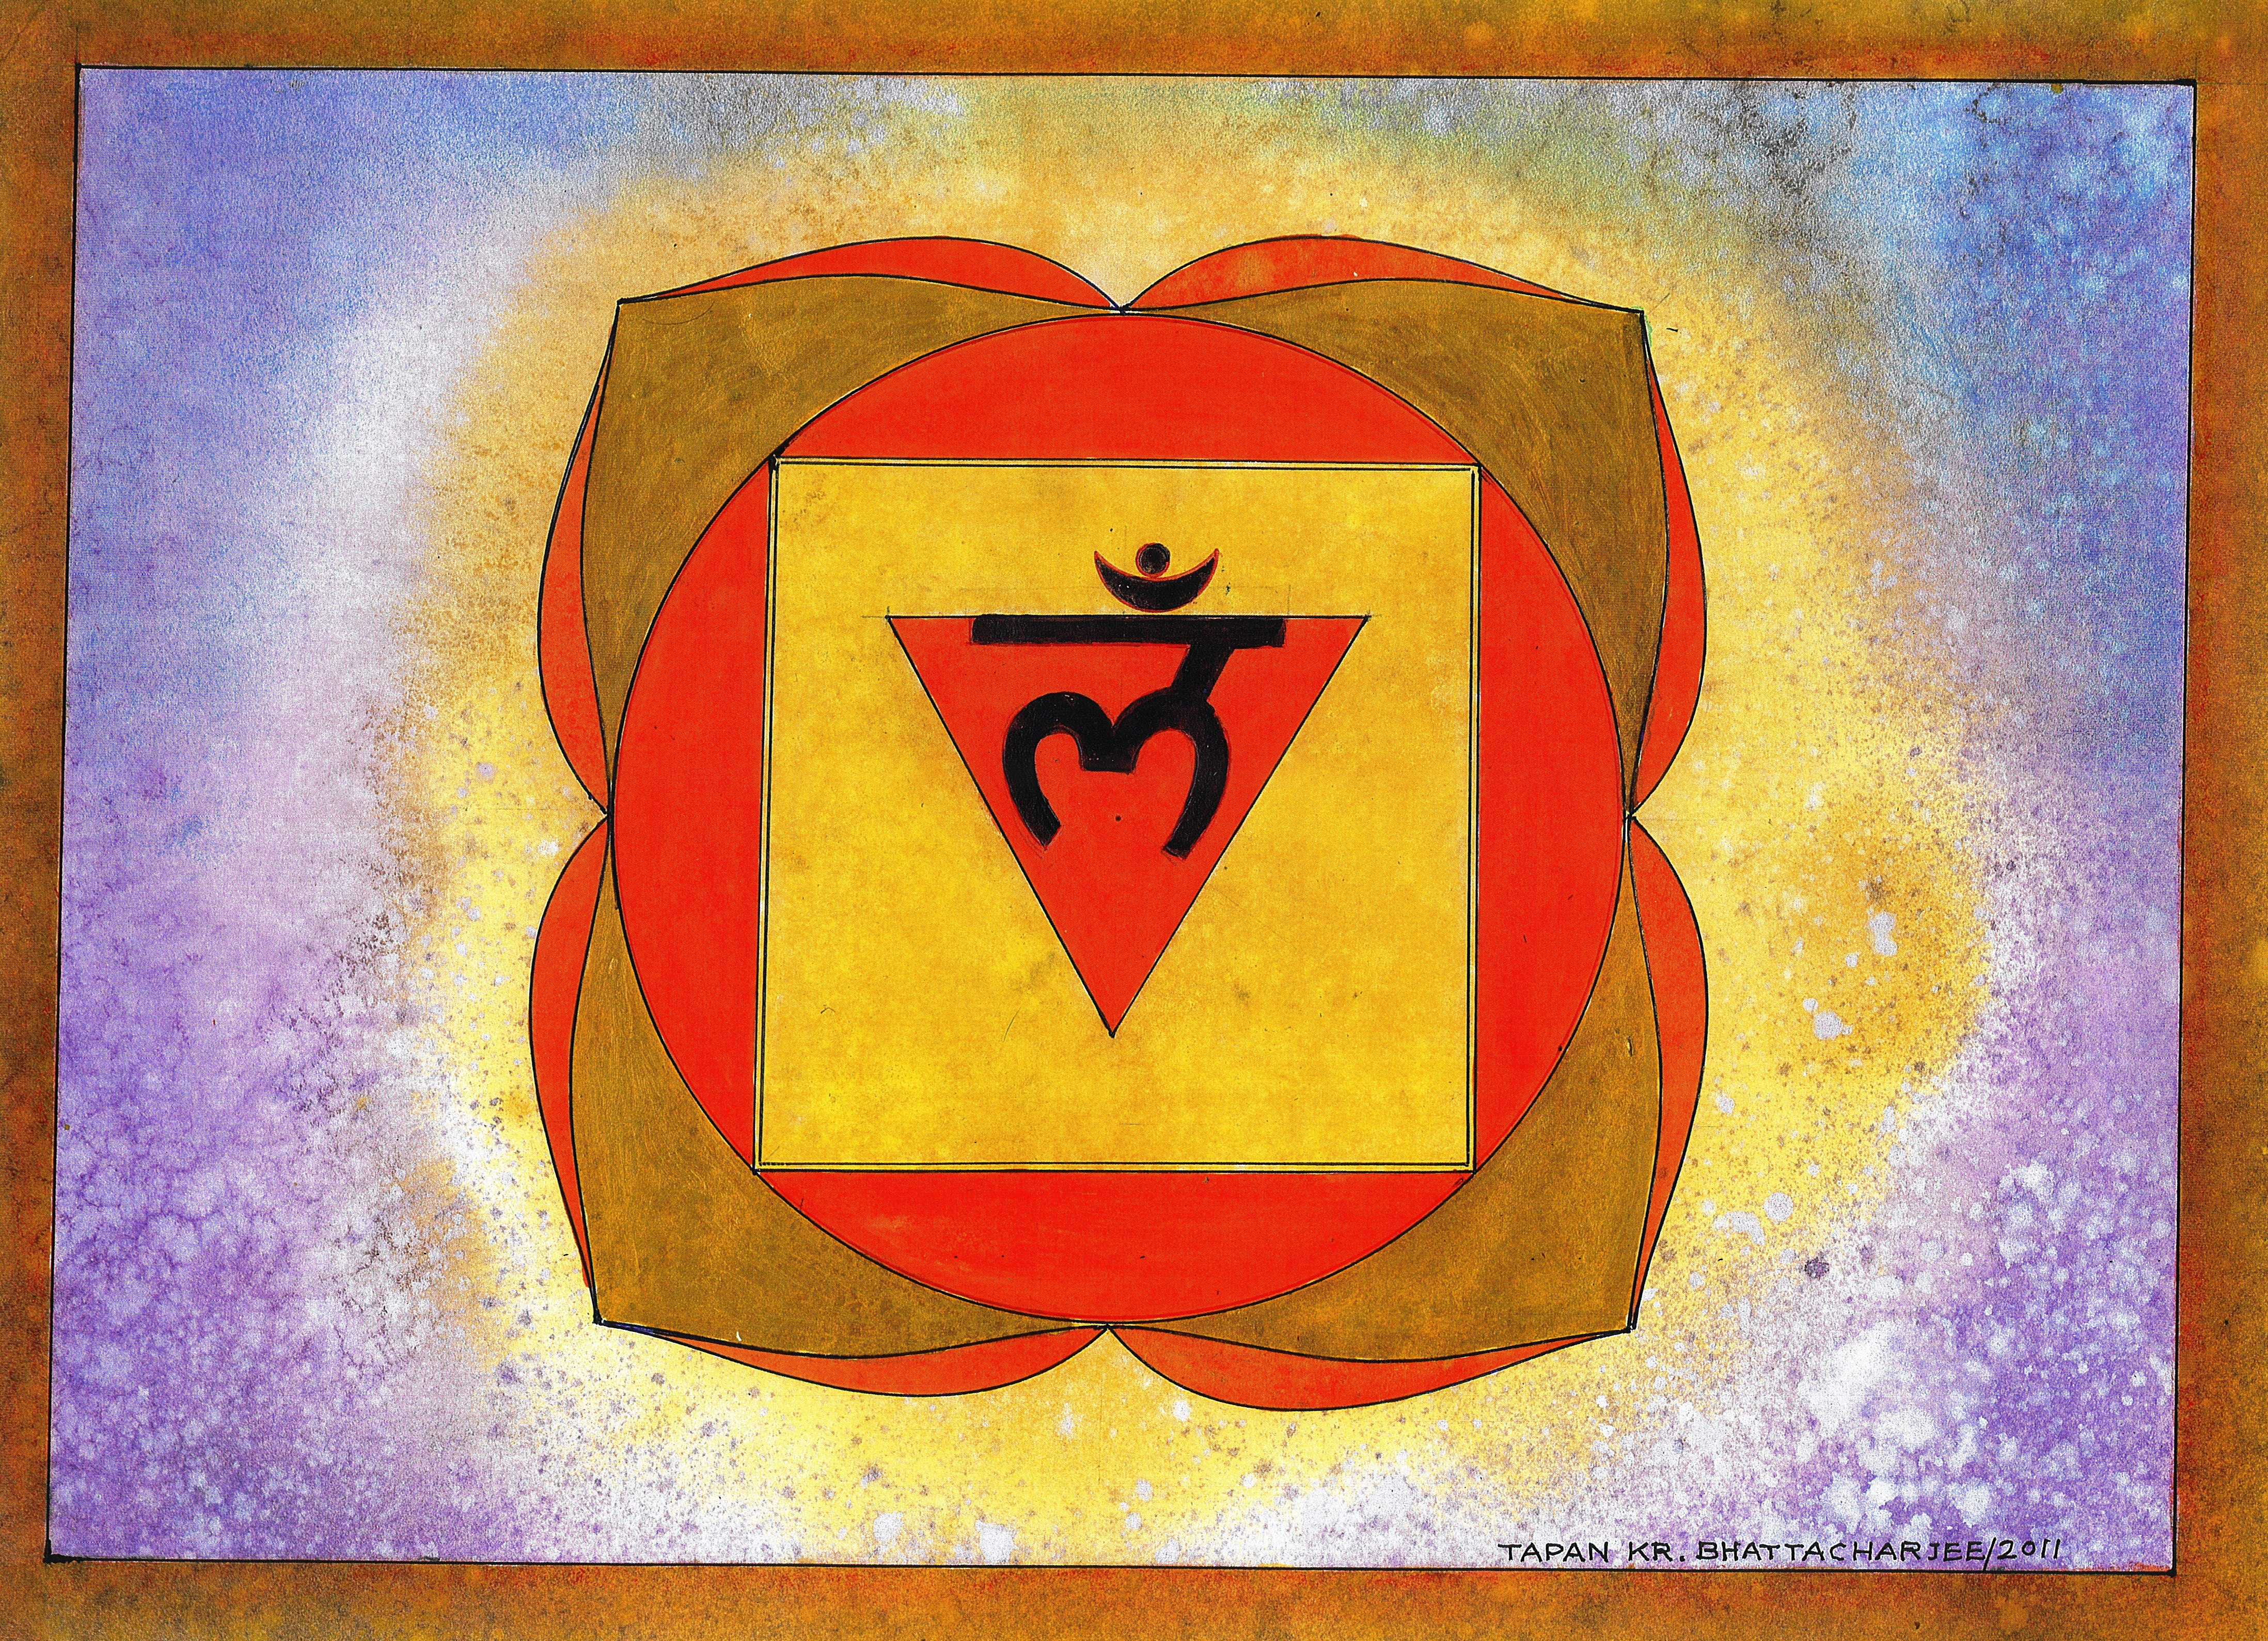
base chakra- muladhara, Gateway of Earth
Element: earth
Location: perineum
Function: grounding, survival, excretion
Glands: gonads, prostate
Colour: red Sound: lam Petals: four
Disease if dysfunctional: Immune problems, lower back pain, sciatica, Piles, rectal cancer, depression.
Base/ Red (Muladhara) Ovaries and testes:-
Controls the production of sex hormones. Overactivity causes sexual obsession, underactivity causes lower sperm count, low libido, bloated fallopian tubes, calcification and symptoms of infertility. Stability

Slide 27
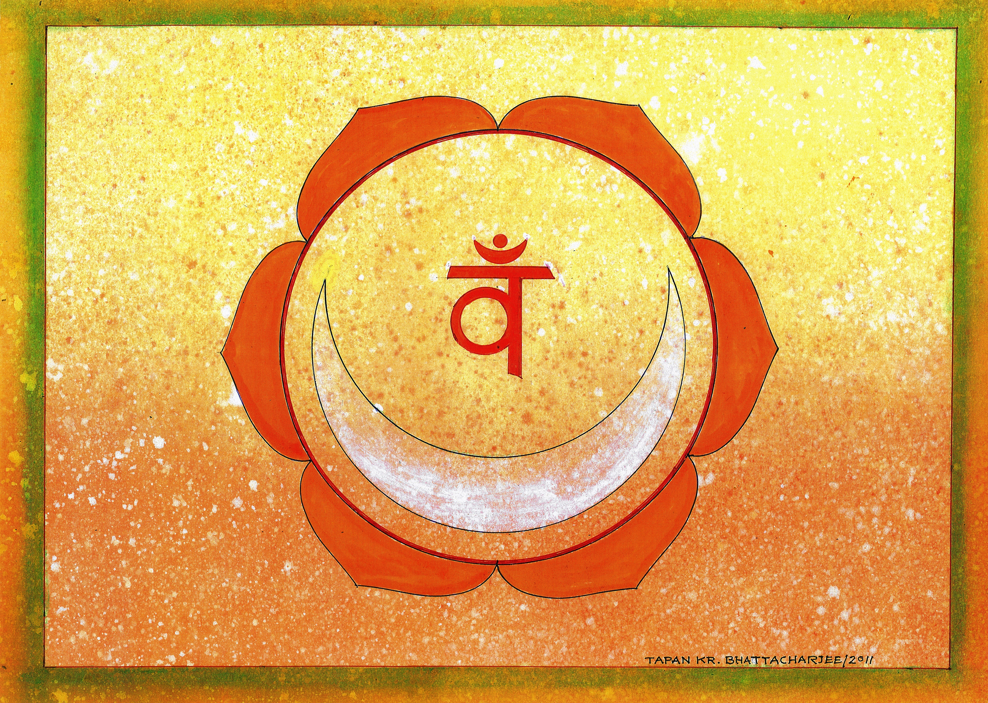
sacral plexus-svadisthana,GATEWAY OF MOON
Element: water
Location: the sacral plexus, two fingers below navel
Function: procreation, creativity and reproduction
Glands: testes, ovaries
Colour: orange Sound: vam Petals: six
Dysfunct: Gyno problems pelvic back pain sexual ailments. Urinary and prostate issues.
Navel/ Orange (Svadistana) Pancreas:-
Regulates the glucose (sugar) levels and metabolism. Stable sugar levels provide consistent energy for cells. Overactivity causes high glucose levels, underactivity causes low glucose levels. Digestive health troubles such as diarrhea and constipation may occur/ Emotional. Relationships.

Slide 28
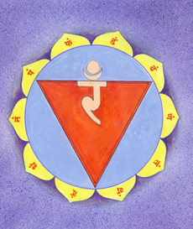
solar plexus- manipura, GATEWAY OF SUN
Element: fire
Location: twelfth thoracic and first lumbar
Function: will, power, digestion
Glands: isles of l in pancreas
Colour: yellow Sound: ram Petals: ten
Dysfunct: Arthritis, intestinal, digestive problems ,ulcers gastric or duodenal; liver, pancreas or kidney, even diabetes and hepatitis
Solar Plexus/ Yellow (Manipura) Adrenals:-
Overactivity causes hypertension whereas underactivity leads to lethargy; affects digestive and urinary systems./ Reflects the true self, represents how a person projects oneself in front of the world.

Slide 29
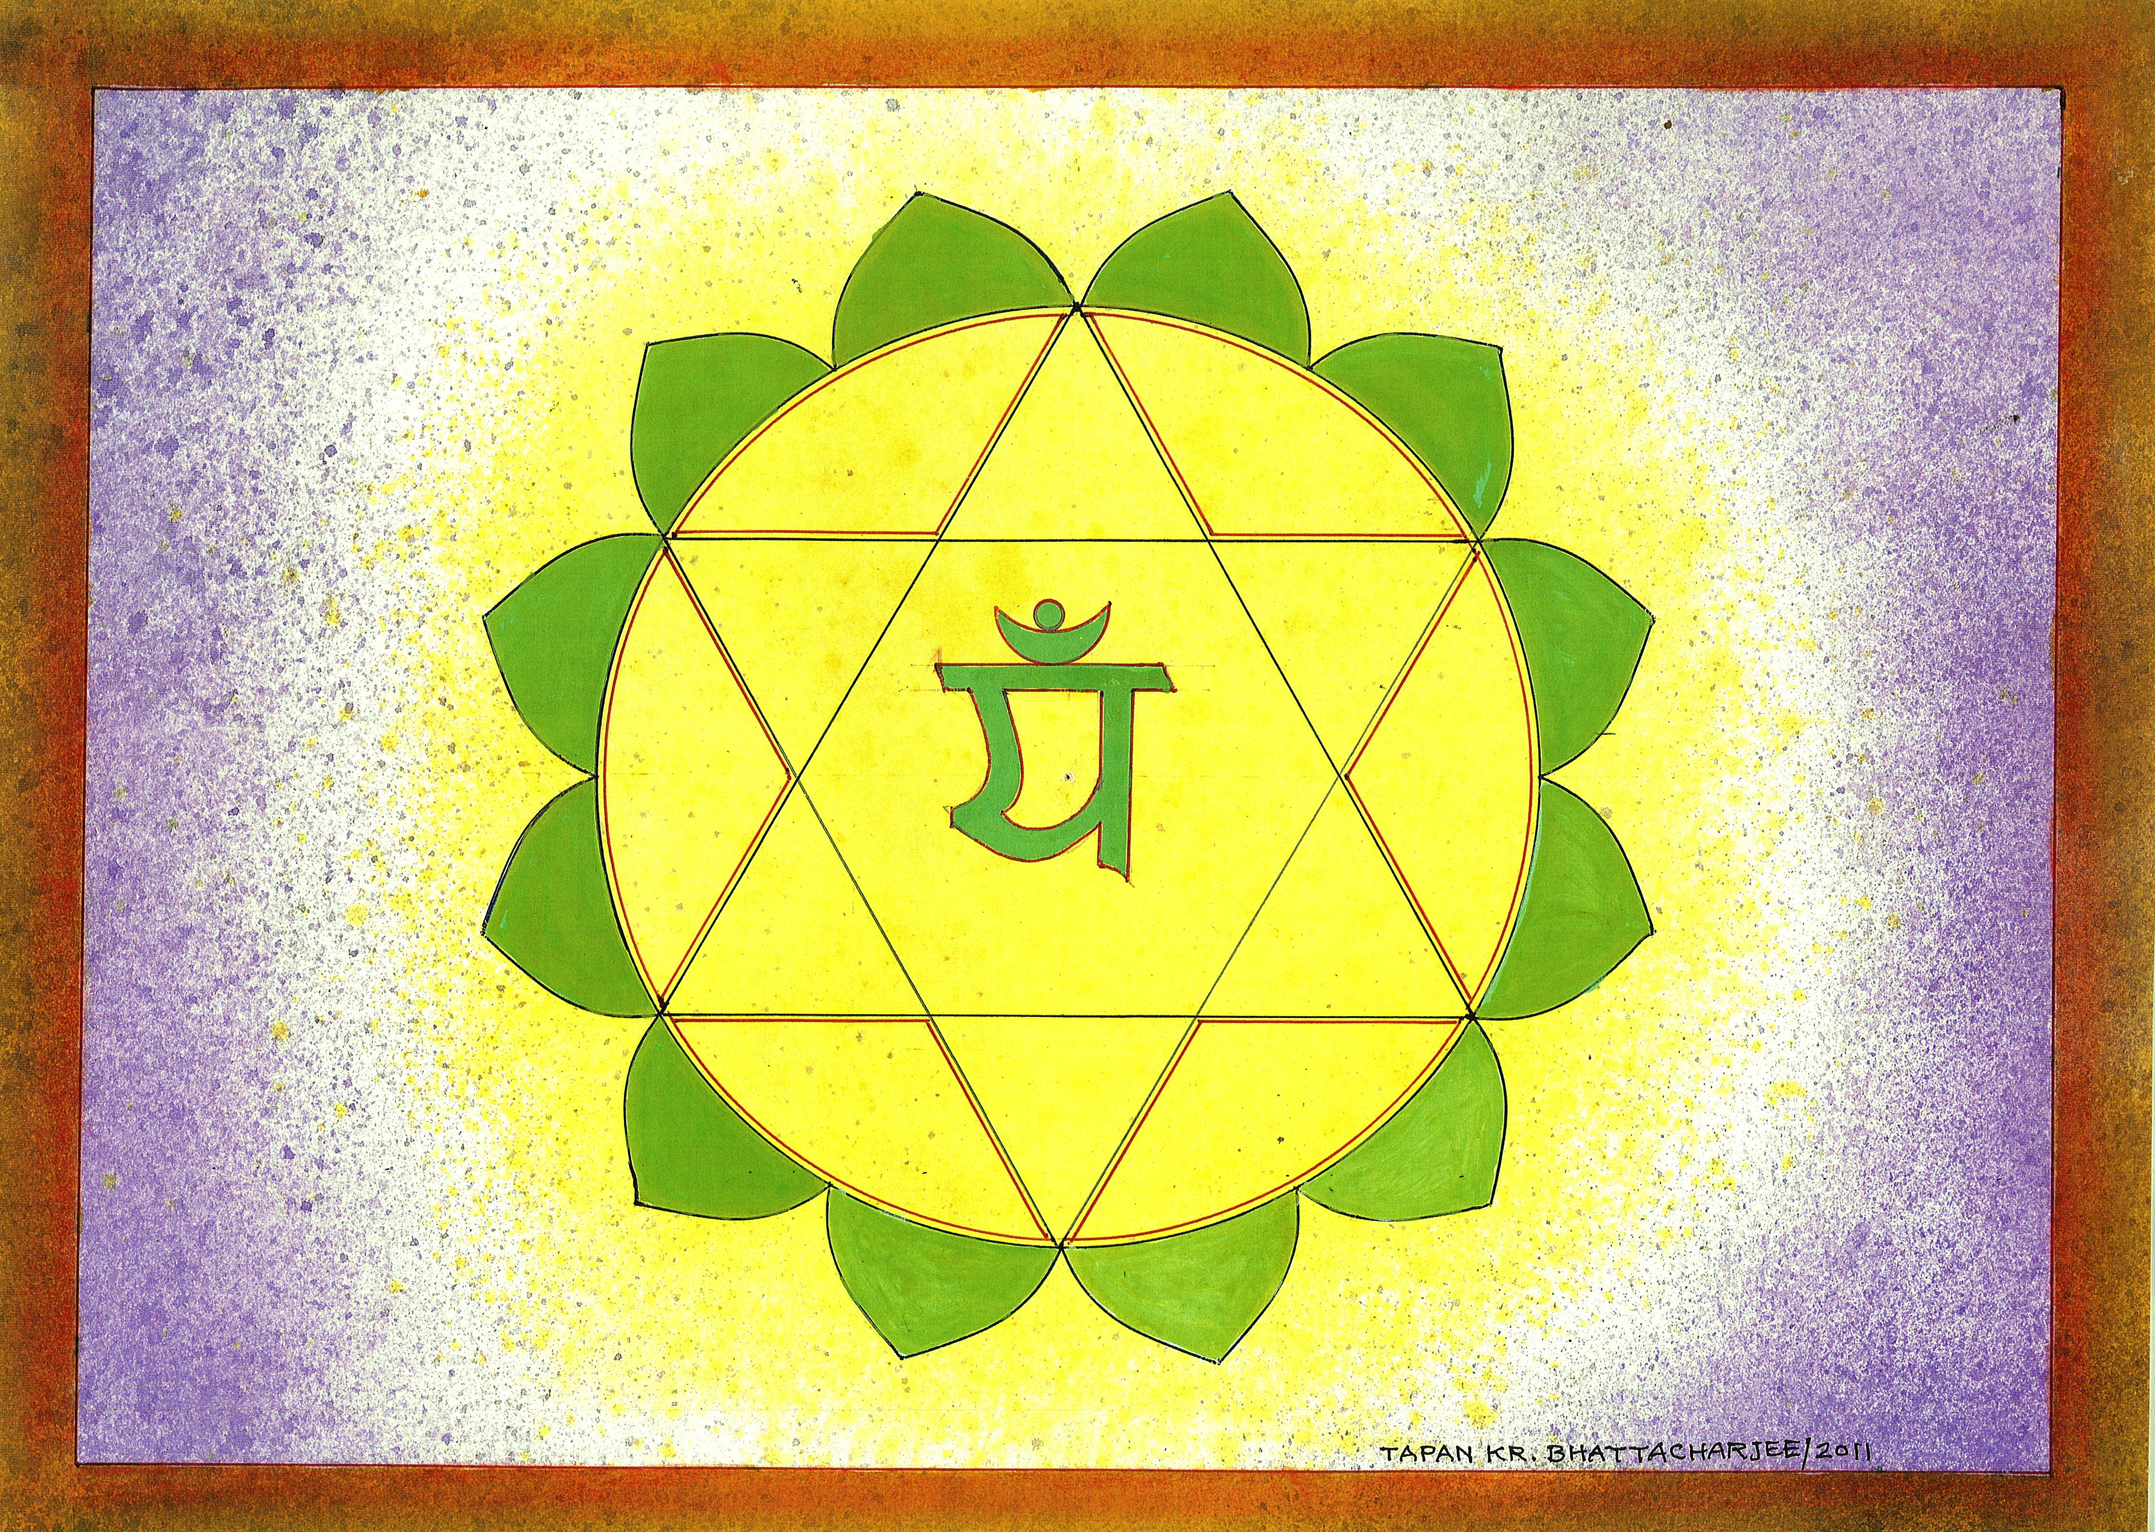
heart chakra- anahata, GATEWAY OF WIND
Element: air
Location: fourth & fifth thoracic vertebrae
Function: love, circulation
Glands: thymus
Colour: green Sound: lam Petals: twelve
Dysfunction: Breast and lung cancer , heart disease, asthma and allergies, pneumonia, growth problems.
Heart/ Green (Anahata) Thymus:-
Immune system- overactivity leads to autoimmune diseases like arthritis, underactivity causes low immunity infections. Cardiac troubles like hypertension, angina/ Area responsible for feelings and emotions

Slide 30
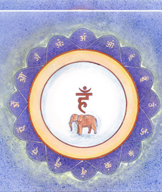
throat chakra- vishuddi, GATEWAY OF TIME & SPACE
Element: akasha
Location: the throat
Function: communication, creativity, respiration
Glands: thyroid and parathyroid
Colour: blue Sound: ham Petals: sixteen
Dysfunction: Throat cancer and laryngitis, thyroid and glandular problems, gum and mouth ulcers.
Throat/ Blue (Vishuddhi) Thyroid:-
Controls general metabolism- Overactivity leads to increased metabolism, underactivity leads to decreased metabolism/ Area related to communication and delivery, non-expressioin, pollution, smoking, throat issues, cavities and metal teeth

Slide 31
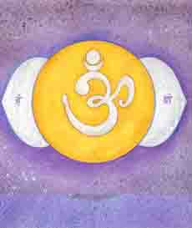
brow chakra- ajna , GATEWAY OF LIBERATION
Element:-
Location: above nose and between eyes
Function: perception and cognition
Glands: pituitary
Colour: indigo Sound: om Petals: two
Dysfunction: Neurological and brain tumours, learning disabilities, eye and ear problems.
Brow/ Indigo (Ajna) Pineal:-
Regulates sleep patterns, diurnal rhythms, Psychic ability

Slide 32
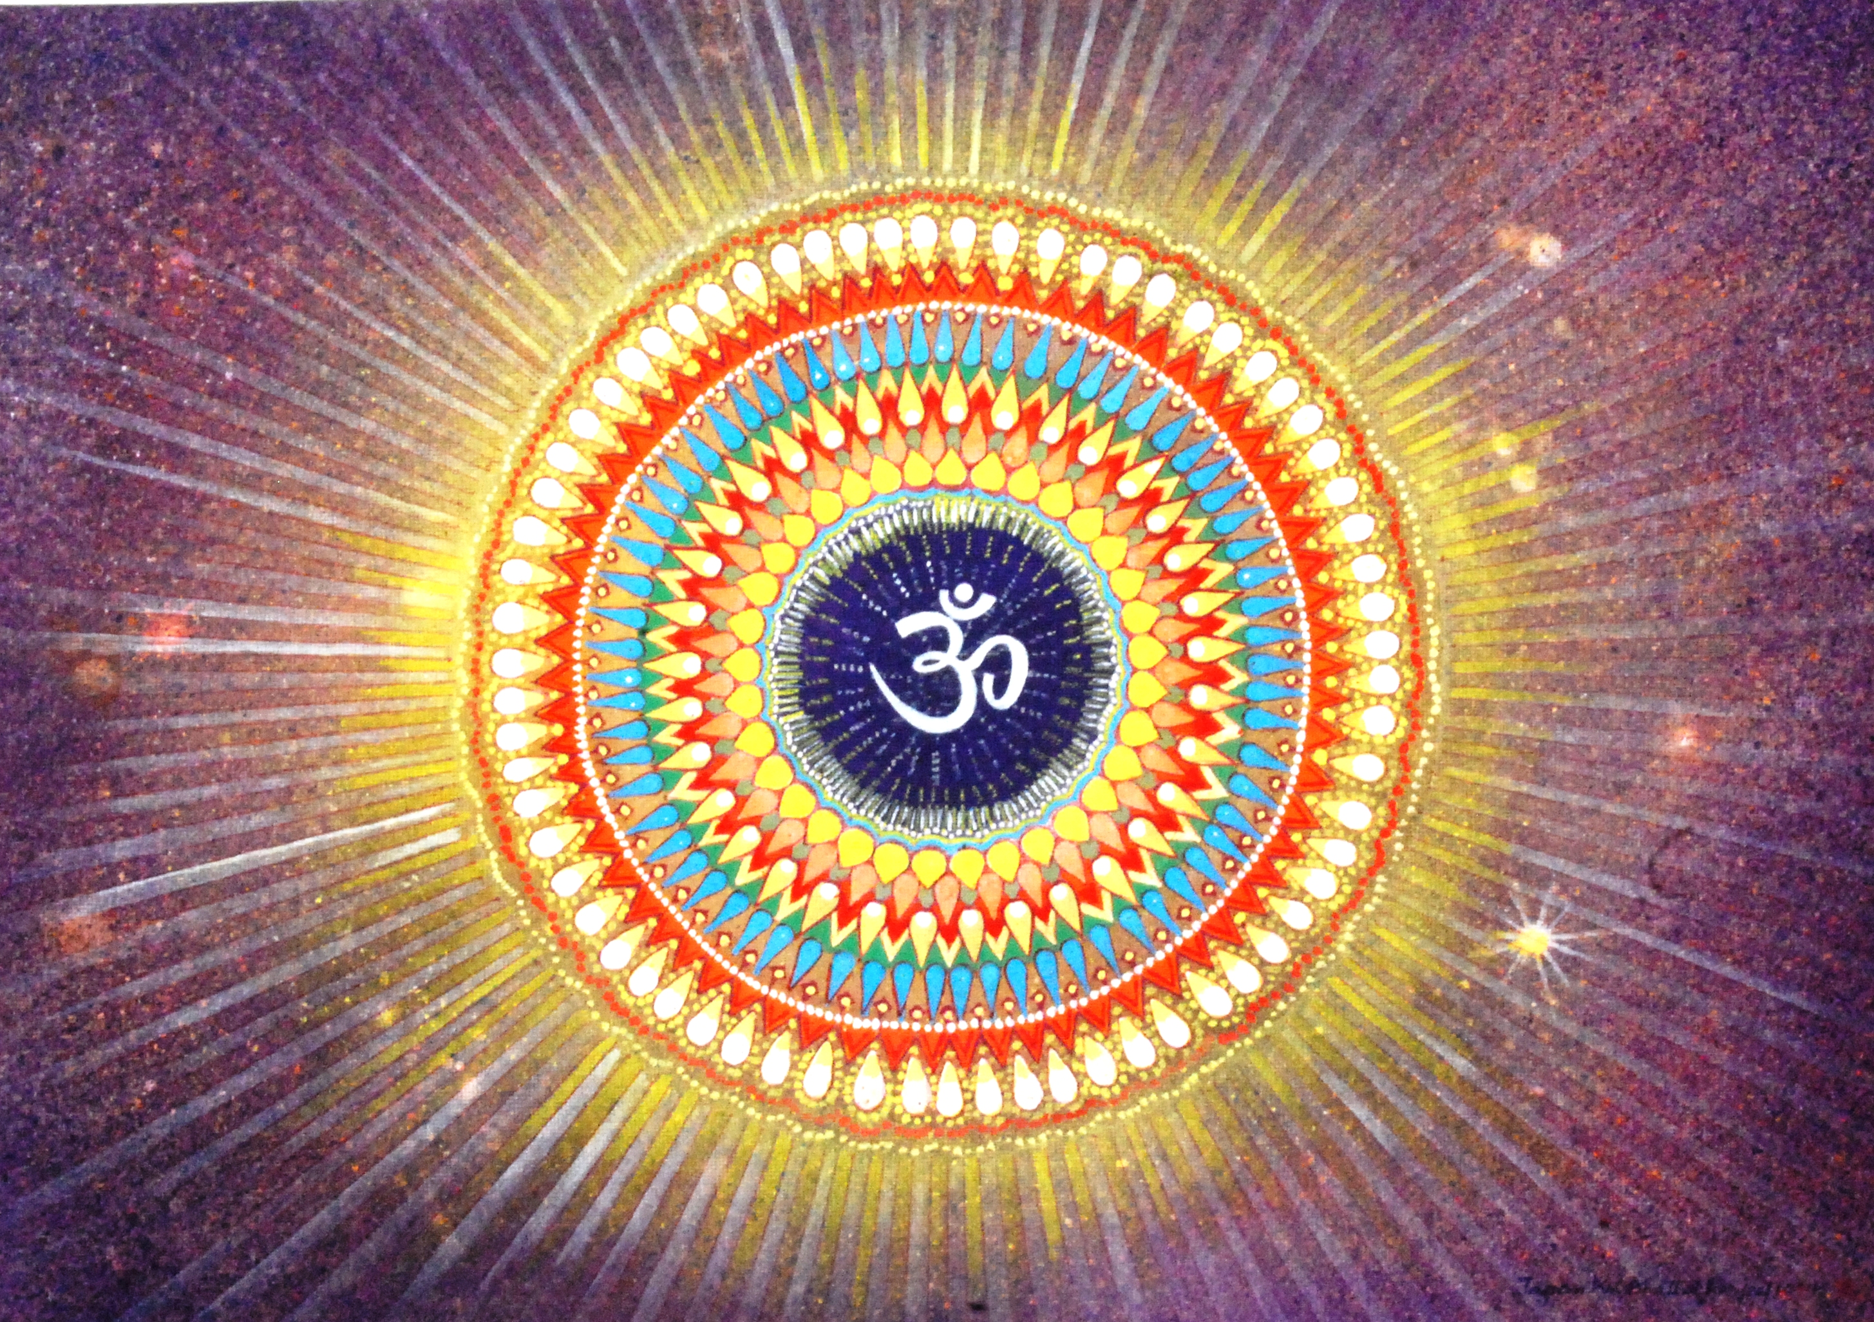
crown chakra- sahasrara, GATEWAY OF VOID
Element:- beyond
Location: crown of head
Function: union
Glands: pineal
Colour: violet Sound: Petals: 998
Dysfunctions: nervous system disorders, chronic exhaustion, brain tumours, spiritual disharmony.
Crown/ Violet (Sahasrar) Pituitary:-
Master gland- controls functions of endocrine glands, influences growth, sex hormones/ Expanse of spirituality

